Slide 1
The top traits which have most impact on performance
Insights from Semifinals and Finals

Slide 2
Purpose of the Analysis
Content: Brief overview of the objectives:
Identify traits that impacted player performance.
Highlight the differences between finalist teams (India and Australia) and others.

Slide 3
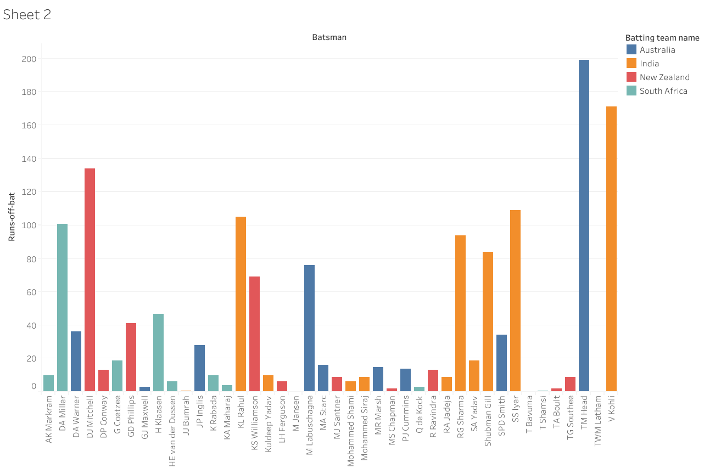
Top Performing Players and Their Impact
Consistent Top Batsmen
Players like Virat Kohli and David Warner stood out for their high runs and consistent performances. Kohli’s ability to accumulate runs with a steady strike rate allowed India to maintain a competitive total, while Warner’s aggressive playstyle provided Australia with a quick start, putting pressure on opposing bowlers.

Slide 4
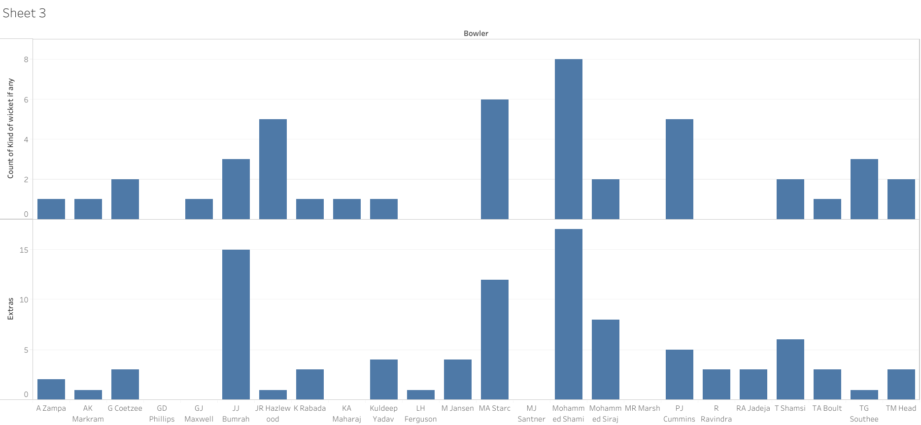
Bowling Efficiency and Wicket-Taking Ability
Bowlers such as Jasprit Bumrah (India) and Mitchell Starc (Australia) were pivotal in maintaining control over the innings by taking key wickets and minimizing extras like wides and no-balls.

Slide 5
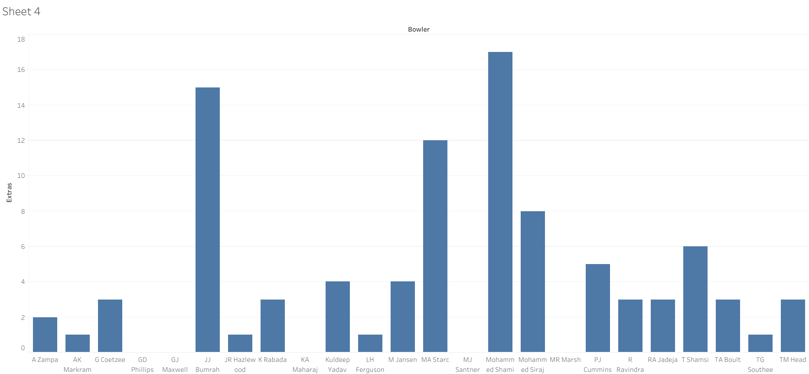
Bowling Discipline and Control over Extras
Both India and Australia maintained superior control over extras, particularly in the form of wides and no-balls, which reduced free scoring opportunities for their opponents. The disciplined bowling strategy helped maintain pressure and forced mistakes from opposing batsmen.

Slide 6

Effective Wicket-Taking Strategies
India and Australia had bowlers who were effective in targeting key batsmen, often taking wickets in critical moments of the game. Australia’s aggressive pace and India’s strategic use of spin played crucial roles in breaking partnerships.

Slide 7
What Set Finalists Apart from Other Teams?
Exploring Key Differentiators in Team Dynamics

Slide 8
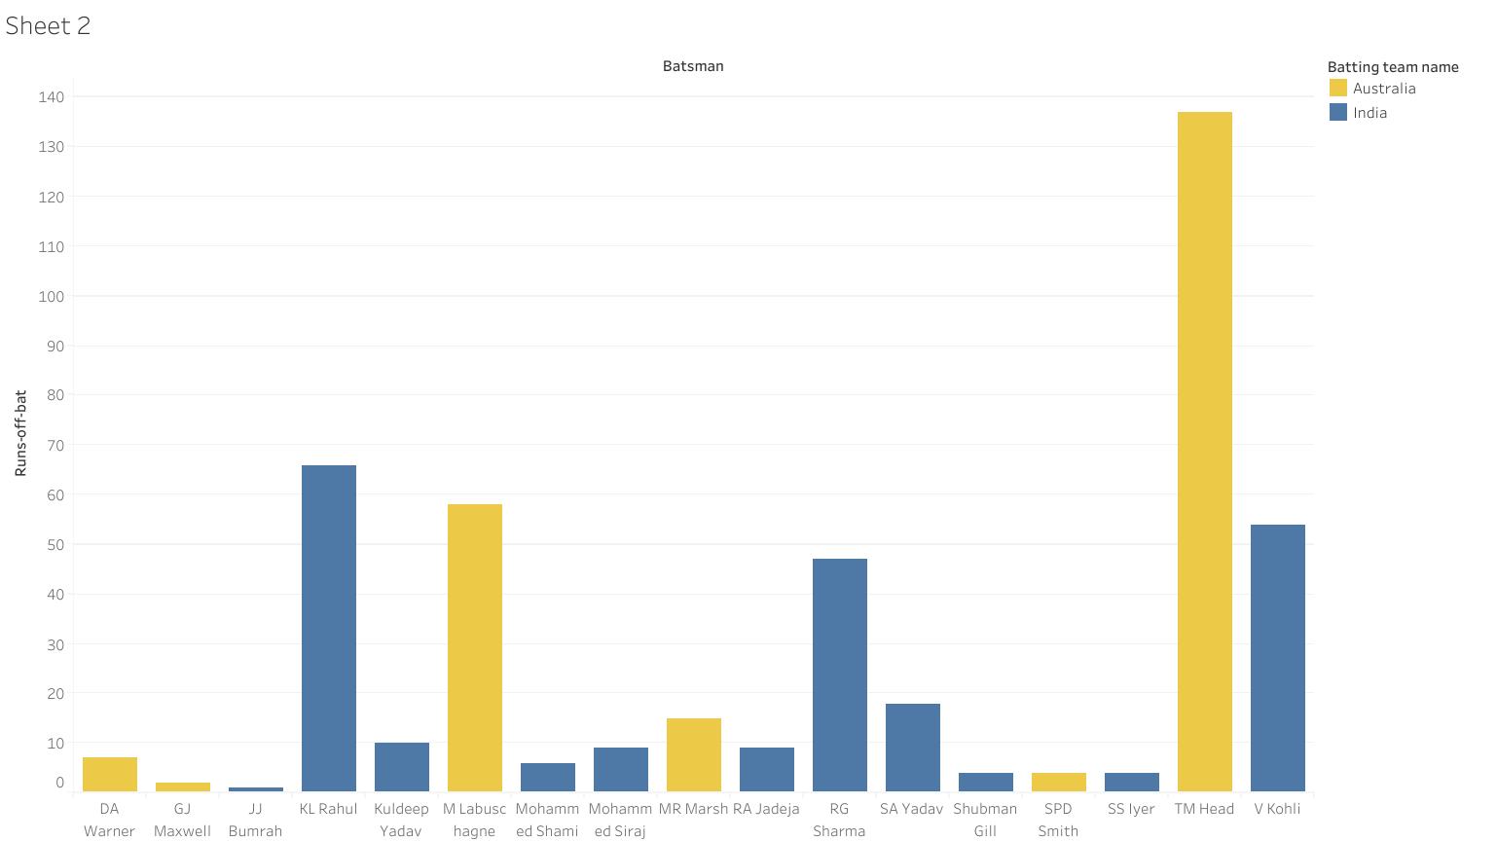
Batting Depth and Consistency
Stronger contributions from top and middle-order

Slide 9
Bowling Discipline and Reduced Extras
Few wides and no-balls, disciplined approach

Slide 10
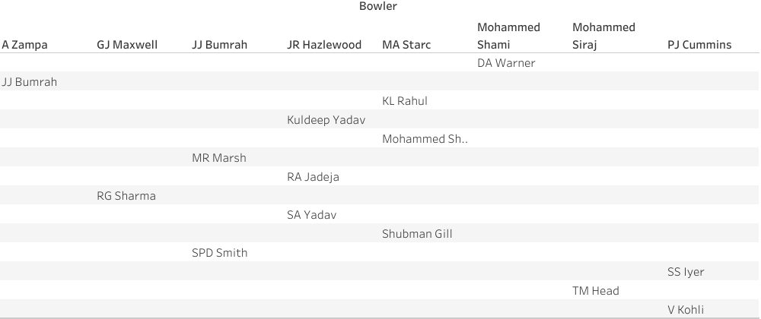
Critical Wicket-Taking Moments
Targeting key batsmen, breaking partnerships.

Slide 11
Summary and Key Takeaways
Batting Depth and Consistency: India and Australia’s strong top and middle-order batting reduced collapses and led to higher scores, unlike non-finalist teams.
Effective Wicket-Taking: Both teams excelled in taking key wickets at critical times, with India using strategic spin and Australia relying on aggressive pace.
Balanced Team Composition: Reliable all-rounders gave both teams flexibility and adaptability, an advantage over other teams.
Discipline and Control: Fewer extras and disciplined bowling helped India and Australia maintain control and momentum.

Slide 12
Concluding Insights and Future Recommendations
Consistent High Performers: Players with high runs, strike rates, and effective wicket-taking abilities (e.g., Kohli, Warner, Bumrah, Starc) played a crucial role in their teams’ success, emphasizing the importance of individual excellence in key areas.
Strong Batting and Bowling Depth: Finalist teams (India and Australia) demonstrated greater consistency in both batting and bowling, particularly with reliable contributions from middle-order batsmen and disciplined bowlers.
Effective Use of All-Rounders: All-rounders like Jadeja and Maxwell provided balance and flexibility, enabling teams to adapt to various match situations and recover from setbacks.
Disciplined Play: Control over extras and disciplined wicket-taking strategies differentiated the finalist teams from others, highlighting the significance of minimizing scoring opportunities for opponents.

Slide 13
Recommandation
Focus on Developing Consistent All-Rounders: Teams should invest in players who can perform in both batting and bowling to create a balanced lineup.
Prioritize Bowling Discipline: Limiting extras and maintaining tight lines can reduce free scoring opportunities for opponents, a key advantage observed in successful teams.
Enhance Middle-Order Stability: Strengthening middle-order consistency can help teams build competitive scores and recover from early losses.
Target Key Wickets at Critical Times: Developing strategic bowling approaches that target key opposition players can disrupt the opponent’s momentum and increase chances of success.

